Slide 1
Target Adjusted Balanced K-Means Clustering
Ananthapadmanabhan Sivasankaran
Muthuraja Palaniappan

Slide 2
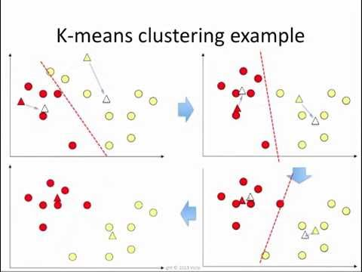
K-Means Clustering
Source: youtube.com/watch?v=_aWzGGNrcic

Slide 3
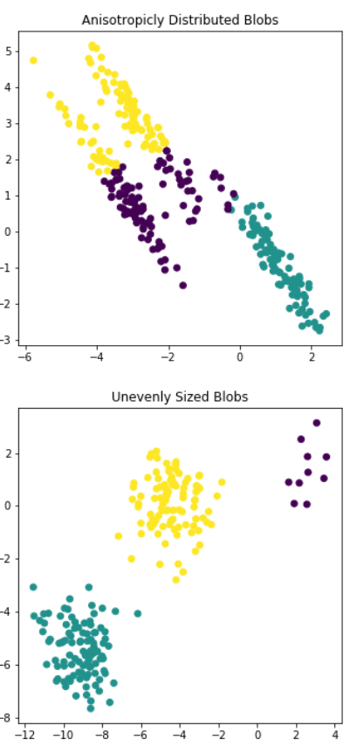
But, they have a lot of problems too…
Clusters sensitive to initial values
Can be solved by multiple iterations with different starting points)
Cluster sizes are not consistent!
Addressed in later slides
Sensitive to outliers
Source: srcole.github.io

Slide 4
Balancing the K-means clusters
Bradley, Bennett, and Demiriz (2000) ensure each cluster will “have at least a minimum number of points in it.” (imposes constraints only on upper bound)
Wagstaff et al. (2001) modify K-Means by incorporating “background knowledge in the form of instance-level constraints.”
C. T. Althoff, A. Ulges, A. Dengel (2000) tried using Frequency Sensitive Competitive Learning (FSCL) algorithm (Assign weights based on number of points in clusters)
In short, lot of progress has been made. But,

Slide 5

Our Motivation

Slide 6
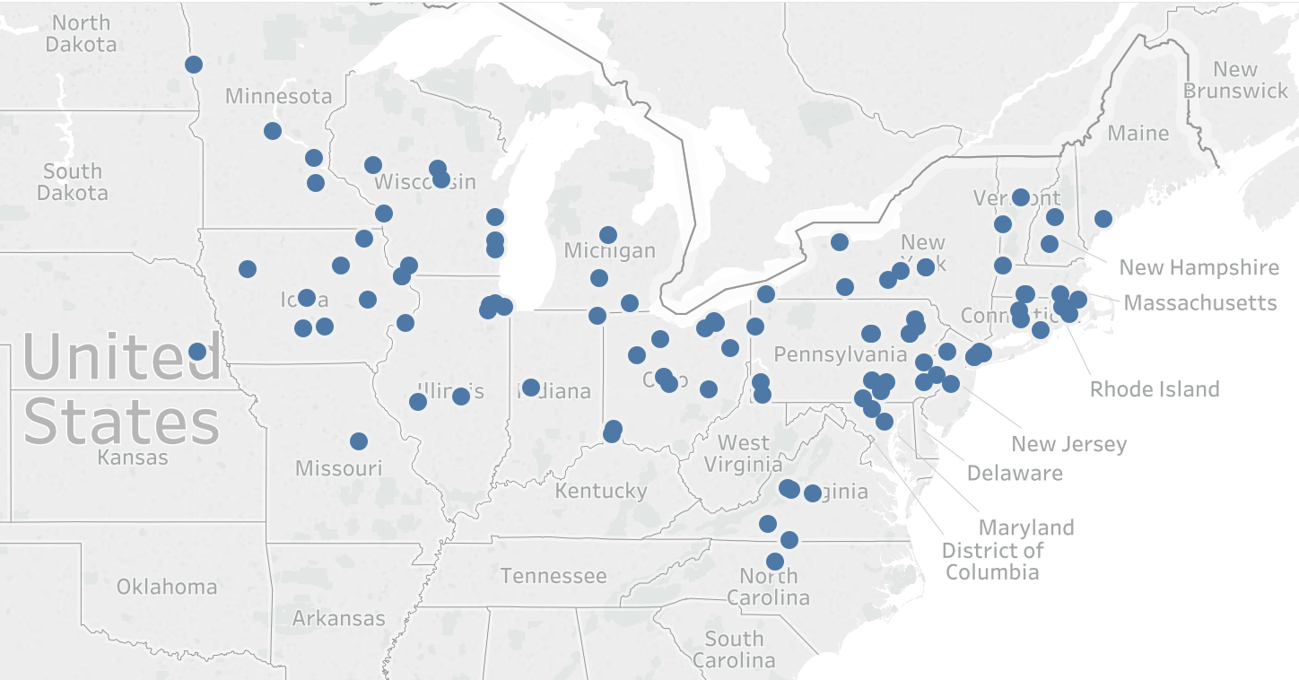
Men’s DIII Wrestling
106 Teams
6 Regions
Top teams qualify for the playoffs
Teams in Division III Wrestling

Slide 7
Division III men’s wrestling (constraints)
Universities closer to each other must be in same region (participants generally drive)
Ratio of maximum to minimum distance would be 2:1
Each region would have almost same number of teams
No more than 20 teams per region and no less than 15
But, most importantly,
All good teams should NOT belong to the same region!!

Slide 8
Other practical applications
Optimal
warehouse location
Salesforce incentivization

Slide 9

Methodology

Slide 10
Comparison with other publications
Balanced k-Means methods​ | Easily implemented​ | Low math complexity​ | Cluster size controlling​ | Robustness to initialization​ | Scalable​
Multicenter clustering (Liang, et al., 2012)​ | ●​ | ​ | ●​ | ●​ | ​
MinMax K-Means (Tzortzis et al., 2014)​ | ●​ | ​ | ●​ | ●​ | ●​
Min-Cut Clustering (Chang, Nie, et al., 2014)​ | ●​ | ●​ | ​ | ​ | ●​
Weight point sets (Borgwardt, Brieden, et al., 2016)​ | ​ | ​ | ●​ | ●​ | ​
Background knowledge (Wagstaff et al., 2001)​ | ●​ | ●​ | ●​ | ​ | ​
Undersampled (Kumar, Rao, et al., 2014)​ | ●​ | ●​ | ​ | ​ | ●​
FSCL (C. T. Althoff, A. Ulges, A. Dengel, 2000)​ | ●​ | ​ | ●​ | ●​ | ​
Balanced K-Means with Hungarian algorithm (Mikko I. Malinen et al., 2014)​ | ​ | ​ | ●​ | ●​ | ●​
Heuristic with Linear Programming (Shunzhi Zhu, et al., 2010)​ | ●​ | ●​ | ●​ | ●​ | ​
Size-regularized inter-cluster similarity (Chen, et al. 2005)​ | ​ | ​ | ●​ | ●​ | ​
Balanced K-Means with equitable distribution of power ratings (this approach)​ | ●​ | ●​ | ●​ | ●​ | ​

Slide 11
Our Algorithm
Compute (Identify) the centers
Cluster all the points to the closest centers
See if any point changed its cluster or maxed-out on iteration
Solve the optimization problem
Compute the distance from the point to each cluster
Identify if points now satisfy the power rating constraints

Slide 12
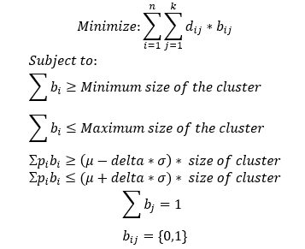
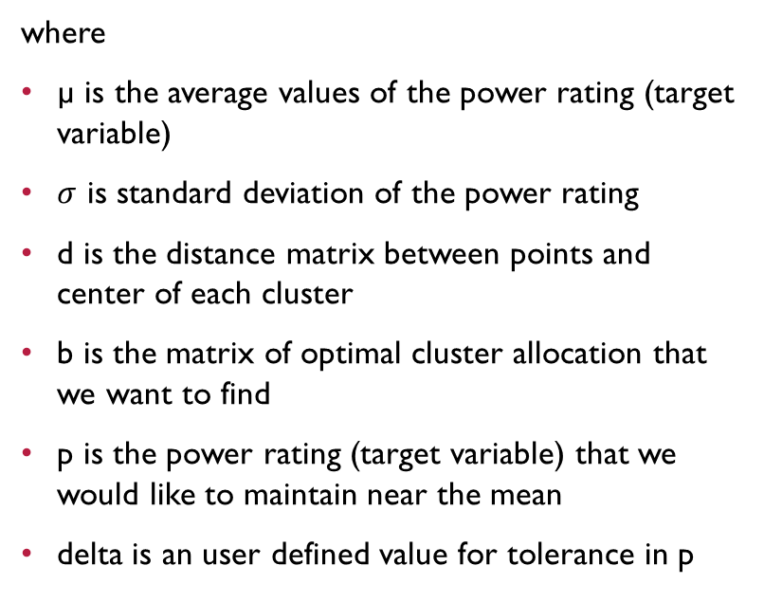
Optimization condition
where
µ is the average values of the power rating (target variable)
$σ$ is standard deviation of the power rating
d is the distance matrix between points and center of each cluster
b is the matrix of optimal cluster allocation that we want to find
p is the power rating (target variable) that we would like to maintain near the mean
delta is an user defined value for tolerance in p

Slide 13
Results

Slide 14
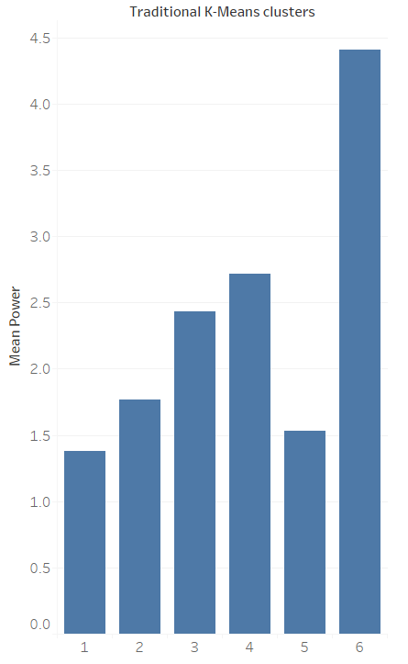
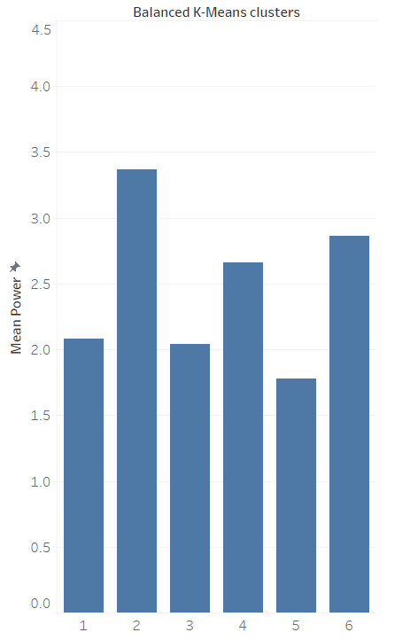
The power ranking of the teams are more equitably distributed…

Slide 15
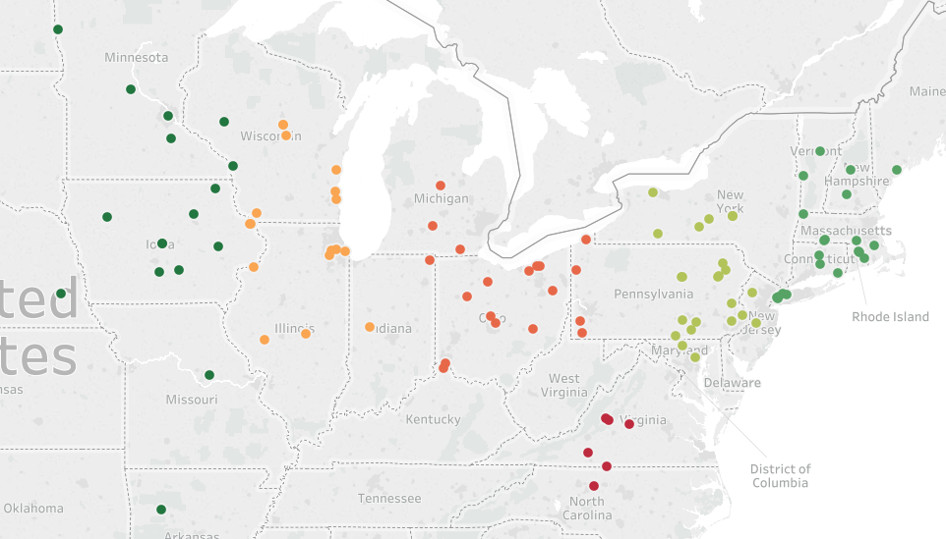
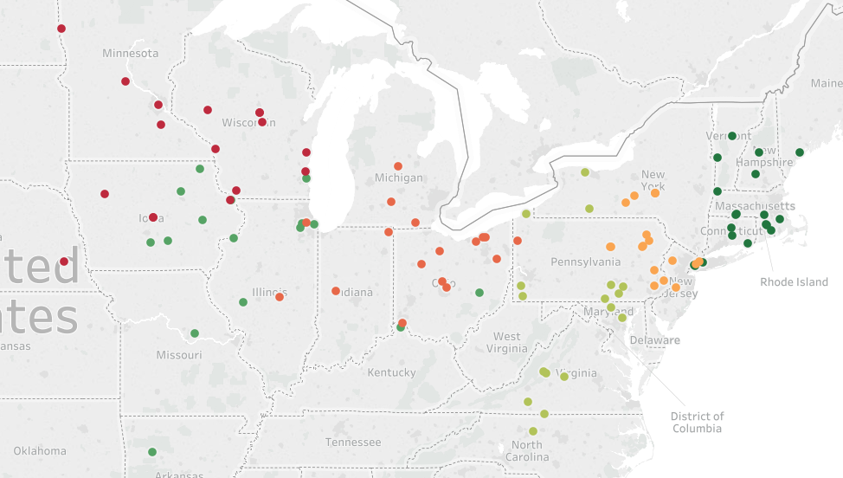
Clusters produced by our algorithm have observations clubbed together in terms of distance and equitably distributed power ratings eg: Wartburg College and Augsburg College are in 2 clusters
Traditional K Means algorithm
Proposed algorithm

Slide 16
Current enhancements to this work
Reduce the computational time complexity
Use sparse matrix
Partial solution is already available
Reduce the memory complexity
Make this solution viable for businesses
CRAN R package will be released soon

Slide 17
Thank you

